Slide 1
National Deep Inference Facility for Hundred-Billion-Parameter LLMs
Alexnet 2012
BERT 2018
Northeastern University
Proposal 2330131
PI David Bau
$18,000,000
5 years
GPT-4 (est) 2023
GPT-3/Bloom 2020
Notes:
Welcome. This is the National Deep INFERENCE Facility project, the NDIF.
It’s an ARTIFICIAL INTELLIGENCE project.
The bubbles here illustrate the SIZE of artificial intelligence models by year. They got HUGE after 2020, and THAT is what the NDIF is DESIGNED to ADDRESS.
I’m David Bau, I am the lead PI on this project. I have four other co-PIs, and we are all here today. They can wave; we’ll introduce them as they present the project. There’s Carla BRAWDly, Byron Wallace, Jonathan Bell, and Arjun Guha.
I want to start by introducing myself, because my OWN experience and track record is a bit unusual for an academic.

Slide 2
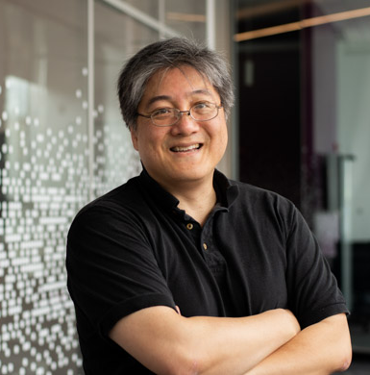
PI David Bau: unique 25-year track record in Industry and Academia
AB Harvard, MS Cornell
Author: Trefethen and Bau
Numerical Linear Algebra
20 years industry experience
Microsoft: 5 years
Program manager for IE web browser
Startups: web platforms
Google: 12 years
Founded and Managed
Google Talk (voice/video/chat)
20 engineers, open platform
Multi-million-dollar infrastructure
Direct impact: 100,000,000 users
lib-jingle, WebRTC, enables Zoom
Image Search Ranking AI
Managed team for Real-time AI image search
PhD MIT, EECS 2015-2021, Pioneer
in Deep Network Interpretability
Assistant Professor at Northeastern University
yellow = Addressing Panel Summary Question
Notes:
I am an Assistant Professor at Northeastern, which means, Academically, I am a BABY – but you can see, I’ve got some gray hairs.
Before my PhD, I built software in industry for 20 years, twelve years at Google, managed a lot of projects.
I want to highlight ONE project, Google TALK, where I CREATED AND LED a team of about 20 engineers. We built text, voice, and video chat on Gmail. My team built a multi-million dollar INFRASTRUCTURE that had about a hundred million DIRECT users. But it had even more INDIRECT effects. the INTERESTING thing is, we ALSO created OPEN STANDARDS that to helped INCUBATE an INDUSTRY. Our STANDARDS and OPEN-SOURCE CODE is why you can ZOOM call, or teams or discord or slack video from any REGULAR web browser today.
I left Google in 2015 to get a PhD at MIT to work on EXPLAINING DEEP NETWORKS.
What EXCITES me about NDIF is that what is needed by SCIENTISTS is OPEN INFRASTRUCTURE. That is EXACTLY the KIND of thing I know how to build.

Slide 3
Intellectual Merit

Slide 4



Enables Transformative AI Research, Auditing and Evaluation on LLMs, Managing Societal Risks of LLMs
Medical advice
LLM
Automated programming
Automated writing
Notes:
So, the NDIF is a project about ENABLING SCIENCE on large-scale language models – LLMs.
And the REASON the SCIENCE of these things are SO important, is that they are getting deployed REALLY quickly in SOCIETY.
They’re being USED in a VARIETY of settings, including HIGH-STAKES areas like giving MEDICAL advice.
They’re doing automated PROGRAMMING, redefining computer science itself.
They will impact almost every field. The Hollywood Writer’s strike right now, is PARTLY about the use of LLMs in AUTOMATED WRITING.
These SYSTEMS are going to have HUGE impact in SOCIETY. And YET, we are in a STRANGE situation as SCIENTISTS,
because even though we can CREATE the systems, we CANNOT EXPLAIN their decisions. They are a BLACK BOX.
So THAT is what the NDIF is DESIGNED to Address. To talk about the SCIENCE, I’ll pass it to my co-PI, Byron Wallace.
He’s a professor at Northeastern, specializing in Natural Language Processing.

Slide 5
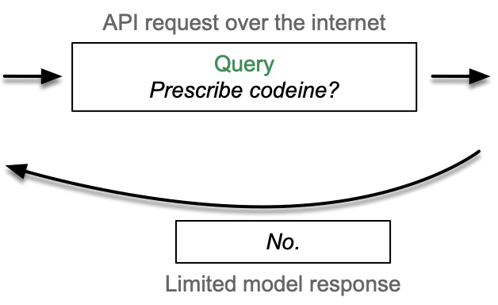

It is Not Currently Possible to Explain an LLM’s Output
LLM
Doctor (end user)
SAFE Innovation Framework by Senator Charles Schumer at CSIS, 6/21/2023: “Explanability is thus perhaps the greatest challenge we face on AI. Even the experts don’t always know why these algorithms produce the answers they do. It’s a black box.”
Notes:
To illustrate the limitations of using commercial LLMs, consider the high stakes example of asking an LLM whether a particular patient should receive pain medication. This query would be passed to a server over the internet via an Application Programming Interface or API.
With commercial APIs such as those provided by OpenAI, the model itself is entirely a blackbox, and the server will simply return a response.
We have no idea how the model came to this particular output. Researchers are therefore unable, for example, to evaluate the degree to which an LLM implicitly relies on racial or other sensitive information. And we can't just "ask" the LLM to tell us why it made a particular prediction, because this is not reliable.

Slide 6
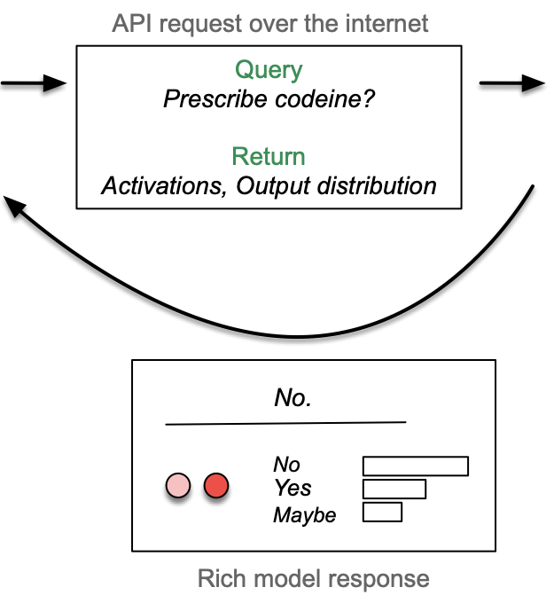

Enabling Deep Inference Research & Applications
NDIF User Research Scientist asking: “Why?”
SAFE Innovation Framework, 6/21/2023: “We will need the ingenuity of the experts and companies to come up with a fair solution that Congress can use to break open AI’s black box.”
Notes:
By contrast, we propose a richer API to be used by researchers. This will allow the users to specify specific things they would like returned along with the LLM output, for instance internal activations or full output distributions over potential responses.
The hosted models will be open-box, with internals and other details made fully available
This request would be sent to NDIF similar to how existing APIs work; the difference would be that the black box is now open.
The return would include both the response (here, "No."), but also the requested additional information - here, internal activations for instance. The researcher could then probe these to see if they code for race, for example.
We have an API design that is tailored for scientists. I will pass it to Jonathan Bell to explain it. Jonathan is a professor specializing in Software Engineering.

Slide 7
Unique Capabilities: NDIF Seamlessly & Efficiently Utilizes Shared Hardware
Advancing research methods: NDIF will provide a rich, remote object API for interacting with a model in Python
Applying deep inference in domains: Open-source interactive tools will provide “no-code” interface
with NDIF("llama-65b", ["Prescribe codeine?"], options) as ctx:
readout = ctx.model.h[0].mlp.output
ctx.model.h[2].mlp.output += intervention
Interactive Tools
Deep Inference API
NDIF Hardware Cluster
Low-Level Deep Inference API Code Example
NDIF’s API will offload all computation to the facility’s hardware
NDIF’s architecture will support multiple (pluggable) models, and will efficiently schedule workloads to minimize setup/teardown costs
Notes:
Two core requirements that we’ve baked into NDIF’s design are: flexibility in adapting to new deep inference methods and challenges, and usability by a broad range of experts in different domains who may not have programming expertise.
As a result, researchers will access NDIF’s large, shared hardware resource of state-of-the-art GPUs using one of two interfaces.
At its core, researchers will interact with NDIF through a Python API that we have designed to quite nearly mimic how ML experimentation works today when using popular libraries like PyTorch. When this code is run, all model interactions will take place on NDIF equipment, bringing the power of the facility directly to the researcher’s workstation.
This remote-object API is nearly infinitely flexible and will scale to support future development of new methods in this field.
We’ll also create an ecosystem of open-source interactive tools that will provide a “no-code” interface to execute these deep inference methods – our first prototypes implement techniques like representation probing and salience mapping, and will be immediately useful for those auditing AI applications in domains. As new methods are developed (e.g. by researchers using the low-level API), our team will incubate new, no-code interfaces for those new deep inference methods.
In this way, NDIF’s execution model effectively allows scientists to embed their own Python code inside of the inference engine, while that inference engine executes on our hardware – this will support the deep inference techniques that we know today, and can continue to evolve to support new methodologies.

Slide 8
Tight, 5-Year Schedule with Full Release in Y3
Budget: 50% hardware; 50% software, training, and outreach
Staged hardware purchase to support next-generation models
Key Milestones
Summer 2023 | 2024 | 2025 | 2026 | 2027 | 2028
Pre-funding prototype for medium sized models | Closed pilot; first round hardware purchase for 175B models | Open pilot; tutorials; second round hardware purchase for 500B models | Full release; multi-site NDIF training and outreach bootcamps | Third round hardware purchase for 1T models; More training and outreach | More training and outreach; release of NDIF software stack for other clusters
Measures:
Milestones
Products
Users
Results
Notes:
We’ve allocated half the budget to acquire hardware that is out of reach for the vast majority of U.S. academics. To defray risks in hardware change, we have planned a staged hardware purchase to support next-generation models.
The other half of our budget is dedicated to:
Creating the open-source software that will implement the API and providing all of the associated user services to the entire US academic community
We have a tight 5-year schedule to deliver the infrastructure, beginning with a closed pilot in Y1, an open pilot in Y2, and a full release in Y3.
We’ve assembled a great team, and are on-track fur our Summer 2023 goals – we’ve already begun implementing a prototype and retained the services of our tech-lead – I’ll hand it off to my colleague Arjun to talk more about our team and organization.

Slide 9

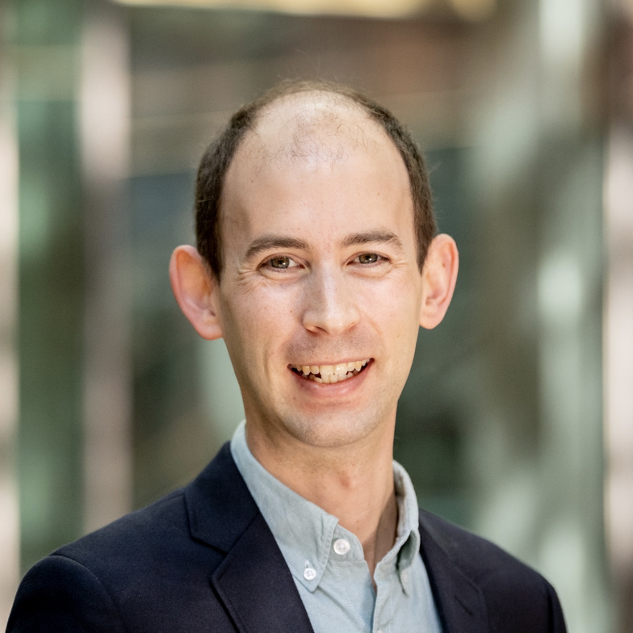
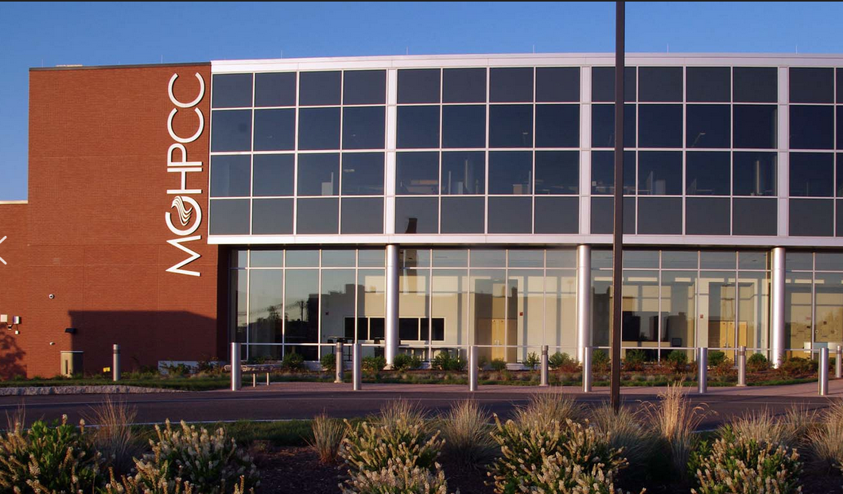


NDIF Team
NDIF is enabled by a team of AI, Software, Hardware and Project Management experts with a strong history of collaboration and a shared vision for deepening our understanding of Large Language Models and helping ensure their positive role in society.
Principal Investigators
Engineering and
Project Management
c
c
c
David Bau NDIF director
Carla Brodley Societal Impact
Byron Wallace Scientific Design
Arjun Guha Science Operations
Jonathan Bell Software Engineering
Will Brockmann Lead Engineer
Sumeet Multani Project Manager
Software Project Management
Major Academic Project Management
ML & Interpretability Research
Programming & Software Research
Project Management Professional
Operations and Project Leadership
fA
Facilities Host
Lead HPC Administrator
Finance and Budget Controller
fA
Community Engagement Partner
Notes:
Thanks Jon.
Here is our leadership team. David has introduced himself.
I want to highlight that Carla also brings a wealth of experience managing major academic projects, having recently completing a 7-year term as dean of Northeastern’s Khoury college of computing.
The PIs’ research expertise is well-aligned with this project, not only including research in large language models and machine learning, but also including research in programming languages and software engineering.
We have already identified and recruited engineering and project leadership, so that we will be ready to begin executing the project on day one.
Our tech lead, Will Brockmann has 20+ years of experience as a tech lead, launching products at Google and elsewhere.
Our project manager, Summit Multani has worked as a project manager for Google, Akamai and TripAdvisor.

Slide 10
Notes:
Here is a view of our org chart including external relationships.
To help ensure that the project maintains its scientific and policy goals, we will form an external scientific advisory board. We have already recruited senior members of the community to serve on out external advisory committee. We will also partner with the public interest technology university network.
The computers will be operated out of the Mass Green High Performance Computing Center, a resource made available at no direct cost to faculty by Northeastern University, and operations and support will be provided by Northeastern’s research computing group.
Our work will be done by four teams: our Operations team, our Software Development team, Outreach Education, and Research Partnerships.
The technical designs will be supervised by our Technical Configuraiton committee.
Our Outeach and Open-Source committees will oversee education and open-source community efforts.

Slide 11
Broader Impacts

Slide 12
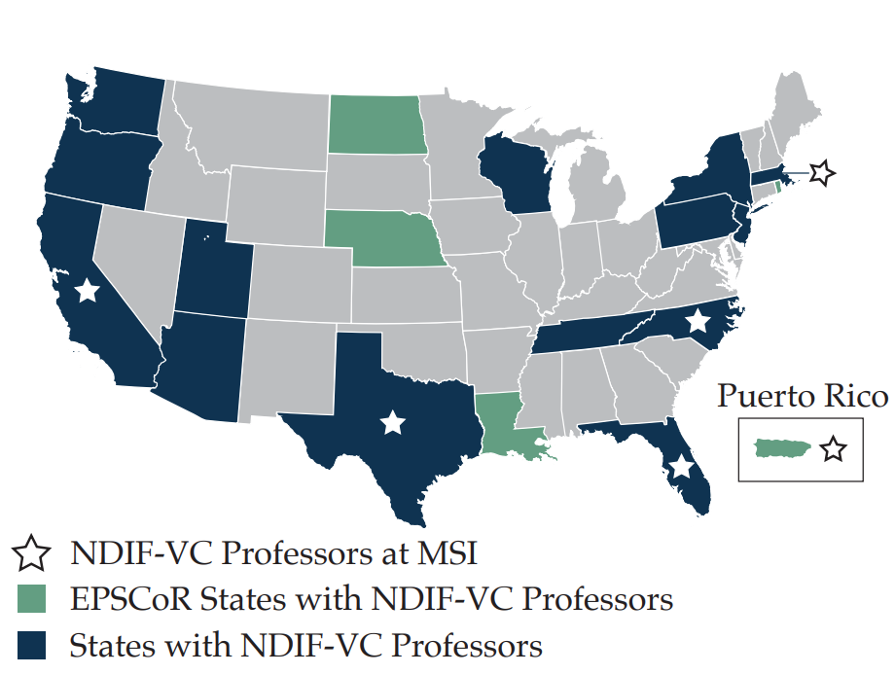
National Impact by Democratizing Transparent Access to LLMs
A national research community
400 researchers indicate that they need NDIF-like resources
Includes MSIs, EPSCoR states, R1, R2, PUI.
A spectrum of fields: neuroscience, medicine, political science, linguistics, computer science
Broader Impacts
Addresses research priority identified by the NAIRR-TF Report (ai.gov 2023) to advance Trustworthy AI
Enables research on AI Safety, Discrimination, Explanation, identified by the White House OSTP AI Bill of Rights (whitehouse.gov 2022)
Directly enables research to break open AI’s black box, a key research priority identified by SAFE Innovation Framework by Senator Schumer (csis.org 2023)
Democratizing transparent access to LLMs, developing nationwide AI workforce, research on impact of AI on society
Our existing virtual community
Notes:
We firmly believe that NDIF is poised to have significant national impact, and will accelerate research across all states and a wide variety of institutions.
This diversity of users nationwide is what will allow NDIF to truly have broader impact. NDIF and associated outreach programs will allow us to train the next-generation workforce in cutting edge AI. By supporting scientists nationwide, we will enable broad nationwide expertise in AI, instead of concentrating it in just a few institutions. And finally, the diversity of fields that we serve is what will us to understand the impact of AI on society.
Several months ago, we conducted an survey of researchers in our networks to ask if they would use a resource like NDIF. We got an overwhelming response from over 400 scientists, all saying that they could not tackle the research questions that they wanted to, due to a unaffordable hardware and technical expertise needed -- both of which NDIF addresses.

Slide 13
Specific Research Plans from Diverse Research Community
Early adopters:
40 professors
7 outside CS
34 universities
8 MSIs
R1, R2, PUI
19 states
5 EPSCOR
Notes:
Here is a partial list of respondents.
Two things to note: they are not all computer scientists from R1 institutions. They represent a wide variety of disciplines, including political science, medicine, and others, and a wide variety of institutions, including institutions in EPSCoR states, HBCUs, R2 schools, and undergraduate-only institutions. In fact, these are the kinds of institutions that for which NDIF will be most transformative.
In fact, we have started to engage in NDIF requirements gathering with faculty and researchers from 20 states already, and these include faculty from MSIs and EPSCoR states. These facutly have identified specific experiments to conduct. They cross geographies, institutions, and fields. They are a diverse group, from many EPSCOR states and MSIs. They will help drive and validate the detailed design.
I am going to hand it over to my colleague Carla BROAD-lee, who will speak further about planning outreach efforts and sustainability plan.

Slide 14
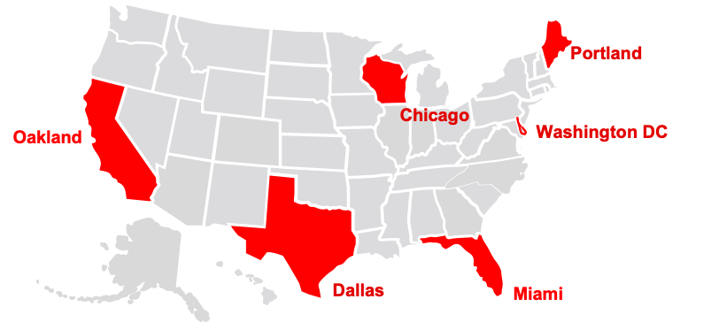
Outreach, Training and Support to Ensure Equitable Access to NDIF
Outreach aided by Computing Research Association, the Center for Inclusive Computing, Public-Interest Technology-University Network, and AI conferences.
Training to develop national expertise:
Training modules
6 regional (300+) grad student bootcamps
Equitable support for students/faculty at less well-resourced institutions via:
Scholarships to attend bootcamps (we have increased the budget) and
Grants for access to priority queues
Notes:
The underlying goal of NDIF is equitable access to LLMs.
We will make sure we reach all constituents across a diverse set of universities via outreach by......
We will train our user group via – modules and online resources/videos/webinars
Then in Year 3 consistent with our implementation goal of full open access, we will run multiday workshops for graduate students in six locations
To ensure equitable access:
Scholarships for students with less well-resourced advisors/universities to attend – we appreciate the feedback that 50k might be signficant and will reallocate resources.
As a pay-for priority access we will ensure a grants system for less well-resources researchers – evaluated by our advisory board.

Slide 15
Continued Operations

Slide 16




Sustainability
Northeastern has committed to sustaining the physical plant
Operating costs will depend on usage (estimate $1-2M/year)
Evolving science/models require 1-2 engineers
Operations and outreach/training requires staff
Funding
Membership fee structure (precedent: currently researchers allocate budget to OpenAI)
Aligned prospective funders
Evaluation protocol will provide use/impact data to engage industry and philanthropists with aligned interests
NDIF is strongly aligned with the goals of Northeastern and we have a commitment from Khoury College to backstop up to $1M of operations
Notes:
Our goal is to have the NDIF evolve after the 5 year period and thus sustainability is a key issue.
We have two commitments from for after the grant period: physical plant and 500k if we cannot raise all of the money via fees and philanthropy.
NDIF is strongly aligned with the future of the university – we have large cross college iniatives on trustworthy AI and human-in the loop applied AI.
We will develop a fee structure from the beginning for priority access and then determine the best way to structure this fee service after the grant period depending on the state of what is available.
We have identified several national foundations who's mission is alligned with the goals of the NDIF and we will raise funds from these entities based on concrete use/impact data. Note that Carla is an experienced fundraisor at the the national level and already has deep connections with all of these foundations, having raised 100M from national philanthropists and industry

Slide 17
Risk-Management Process
Monitor
Public Impacts
Science Leadership
Identify
External Advisory Board
Engineering Leadership
Outside
Partners
Control
User Community
External Vendors
Analyze
Project Manager Coordination
(4.2.7 in proposal)
Notes:
Thanks Carla. Before we wrap up, I want to talk about a couple things that came up in our reviews.
One was a question about our risk management process.
I am really happy to say, we have already identified a project manager that we’re ready to hire.
One of things he’s going to do is drive a continuous risk management process.
Working with every member of leadership, as well as internal and external stakeholders, we will identify and analyze risks.
He will direct a process to maintain the Risk REGISTER, and we will control and monitor risks over time.

Slide 18
Risk-Management Process
Regular risk register updates
WBS | Risk | Type | Prob | Impact | Strategy
1.1.1, 1.3 | Staffing risk. Delays in hiring / limited availability of software engineers | Workforce | Med | Med | Avoid: Pre-funding recruitment
1.3.5 | Science risk. Feature creep, software requirement changes | Software quality | Med | Low | Mitigate: Phased development
1.4.2 | User risk. Lack of interest or low adoption | Software quality | Low | Low | Avoid+Mitigate: User surveys during design
1.2.1 | Infrastructure risk. Unexpected changes in hardware availability or needs. | Cost | Low | Low | Mitigate: Benchmark alternatives
1.5 | Use risk. Misuse of AI whether intentional or unintentional | Public impact | Low | High | Avoid+Mitigate: ToS review, IRB. NU Comms + Ethics team
Notes:
Here are some parts of our risk register.
I want to talk about the first line, also a review question. One of our big risks is Staffing, because we’re in competition with lots of very cash-rich companies for software engineering talent.
To avoid this risk, we have been recruiting our key staff members already. We’ve been working for six months on recruiting.
There was a question by a reviewer that we have an eleven-month timeline to fully staff. That’s true – some of the operations staff we will not hire until late in the year.
However, all the staff who are on the critical path – our leadership, and key engineers -- they will be hired on day one, because we are already hiring them NOW. We already have our lead engineer hired, we already have our program manager identified.

Slide 19
Key Performance Indicators
Outputs
Users
Impacts
Inference Capacity
LLM models
Open-Source Library
Probing methods
Productivity
Online User Interface
Non-coding usage
Scalable Training
Online materials
Curriculum
User Adoption
Number of users
Utilization
User Reach
Geographic diversity
Intersectional diversity
Trained Users
Workshop participation
Online participation
Classroom use
Scientific Discovery
Fundamental understanding
Multidisciplinary research
Count citations, discoveries
Trustworthy AI
Enables auditing of biases
Evaluations of AI risk
Mitigations of AI risk
Workforce Development
Employers use of platform
Measures:
Milestones
Products
Users
Results
Notes:
I also want to talk briefly about success metrics.
We see this science infrastructure as aiming towards broad long-term impacts: scientific discovery; trustworthy AI, workforce development
We will MEASURE our PROGRESS towards those goals by tracking our OUTPUTS. That includes our service CAPACITY, the CAPABILITES of our open-source LIBRARY, our INTERFACES, our TRAINING MATERIALS
Then we will track USERS. NUMBER of USERS and their UTILIZATION. And also their DIVERSITY. And Participation in our OUTREACH and TRAINING.
FINALLY, we will track IMPACTS. PAPERS that CITE our INFRASTRUCTURE, FUNDAMENTAL DISCOVERIES that we enabled.
Research across disciplines, research into BIASES and RISKS. We will measure if EMPLOYERS are seeking out users’ expertise.

Slide 20
Transparency for black-box large language models
Enabling transformative science across fields
Address societal needs: AI workforce, trustworthy AI
LLM
Notes:
So that is our project proposal – it is designed to enable science into the most important AI systems today.
It will bring transparency to black-box artificial intelligence,
it will enable transformative science across many fields, not just computer science.
and it will address pressing societal needs: workforce development, trustworthy AI.
NDIF.
Any questions?

